Slide 1
Bird Strike Analysis
PRESENTATION
Presented By:- Vivek Kumar

Slide 2
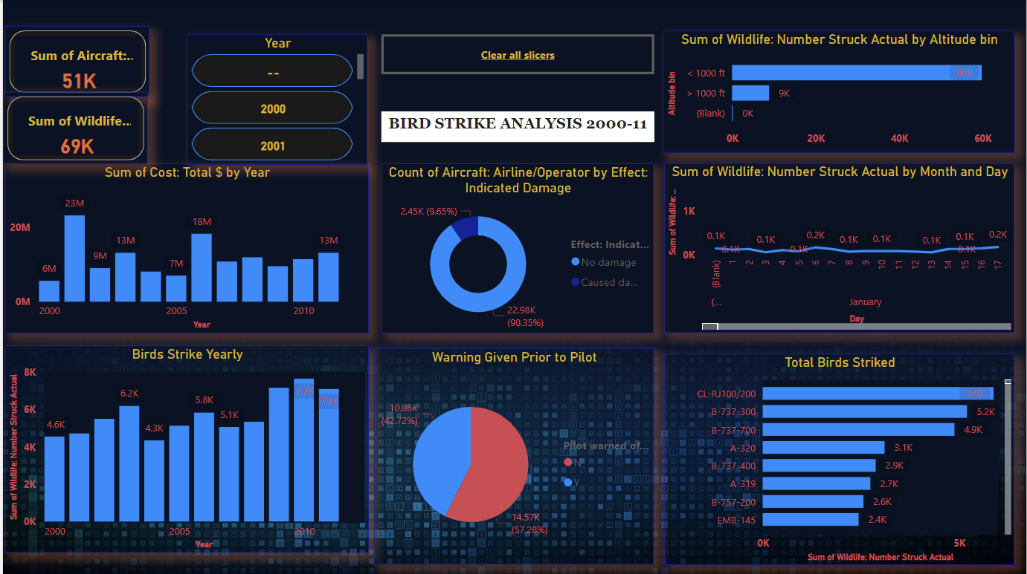
Dashboard represents insights of all data collectively.
More than 90% of strike didn’t made damage.
There is very small difference between prior warning and not warning to pilot.
Most of the strike was above 1000ft.
Highest damage costs 23M in year 2001.

Slide 3
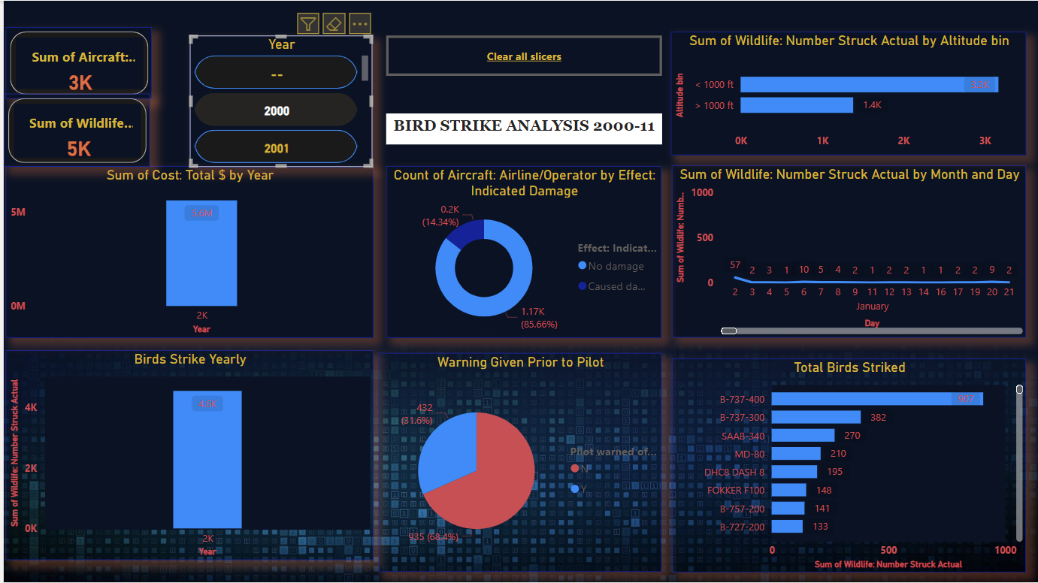
Year Wise representation:-
3000 aircrafts striked with 5000 birds in year 2000.
Total damage costs around 5.6M.
Unwarned strike is more in this year.
907 birds were striked with aircraft B-737-400

Slide 4
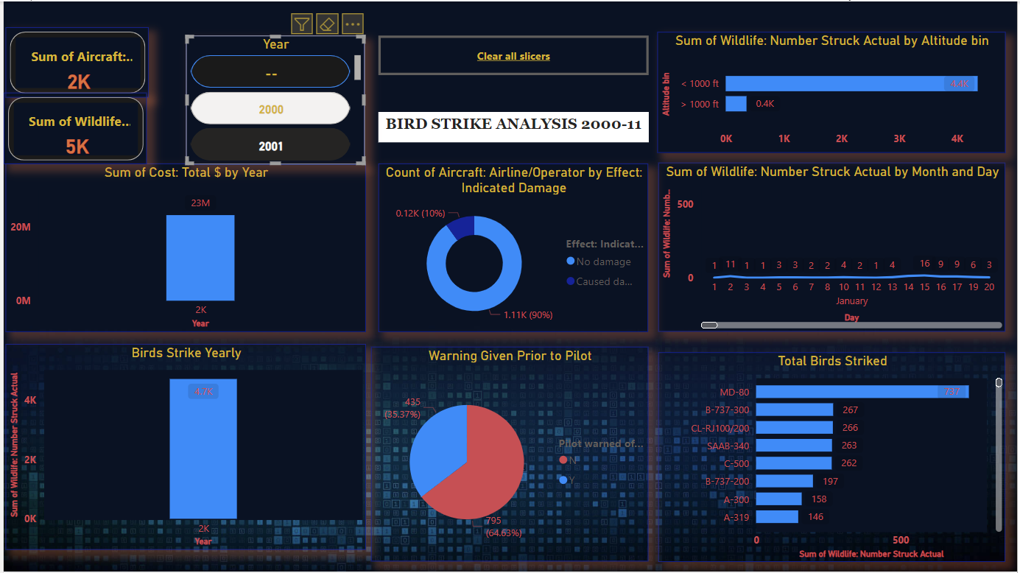
Year Wise representation:-
2000 aircrafts striked with 5000 birds in year 2001.
Total damage costs around 23M.
Unwarned strike is more in this year.
737 birds were striked with aircraft-80.

Slide 5
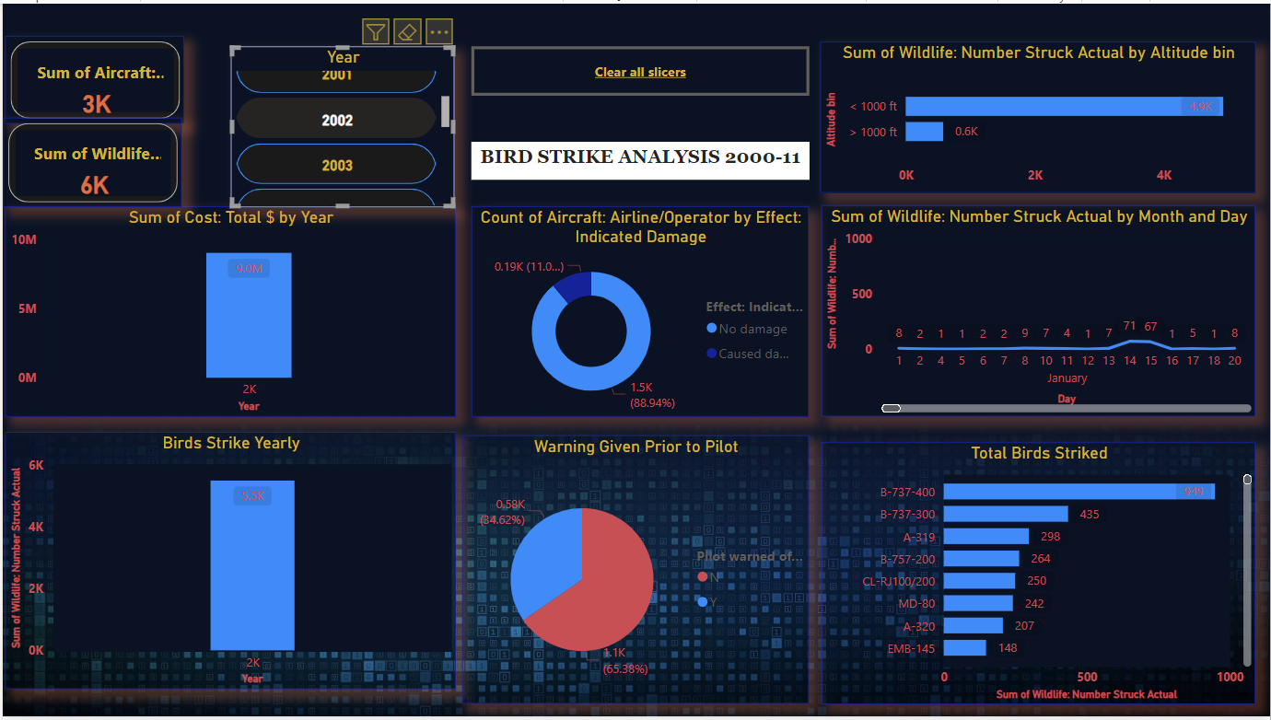
Year Wise representation:-
3000 aircrafts striked with 6000 birds in year 2002.
Total damage costs around 9M.
Unwarned strike is more in this year.
949 birds were striked with aircraft B-737-400

Slide 6
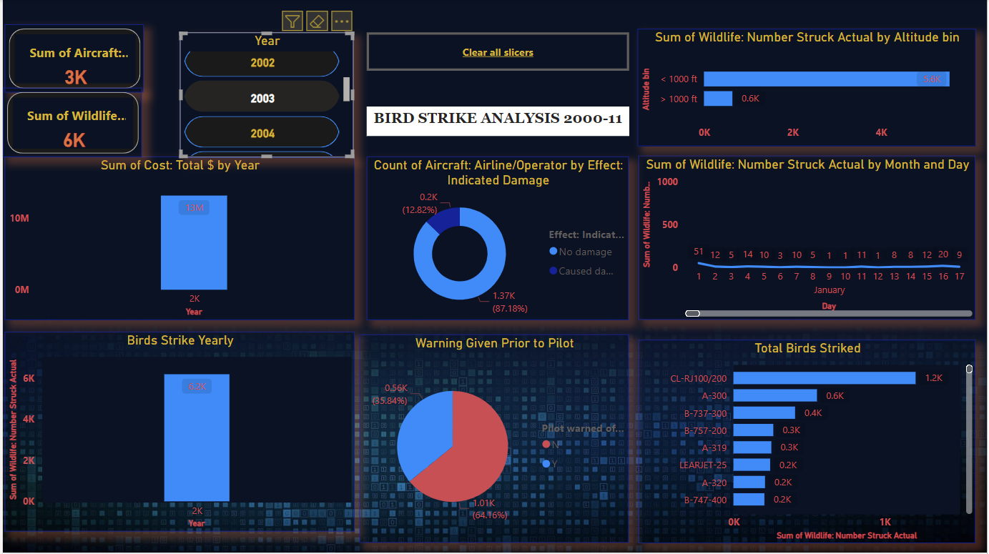
Year Wise representation:-
3000 aircrafts striked with 6200 birds in year 2003.
Total damage costs around 13M.
Unwarned strike is more in this year.
1200 birds were striked with aircraft CL-RRJ100/200

Slide 7
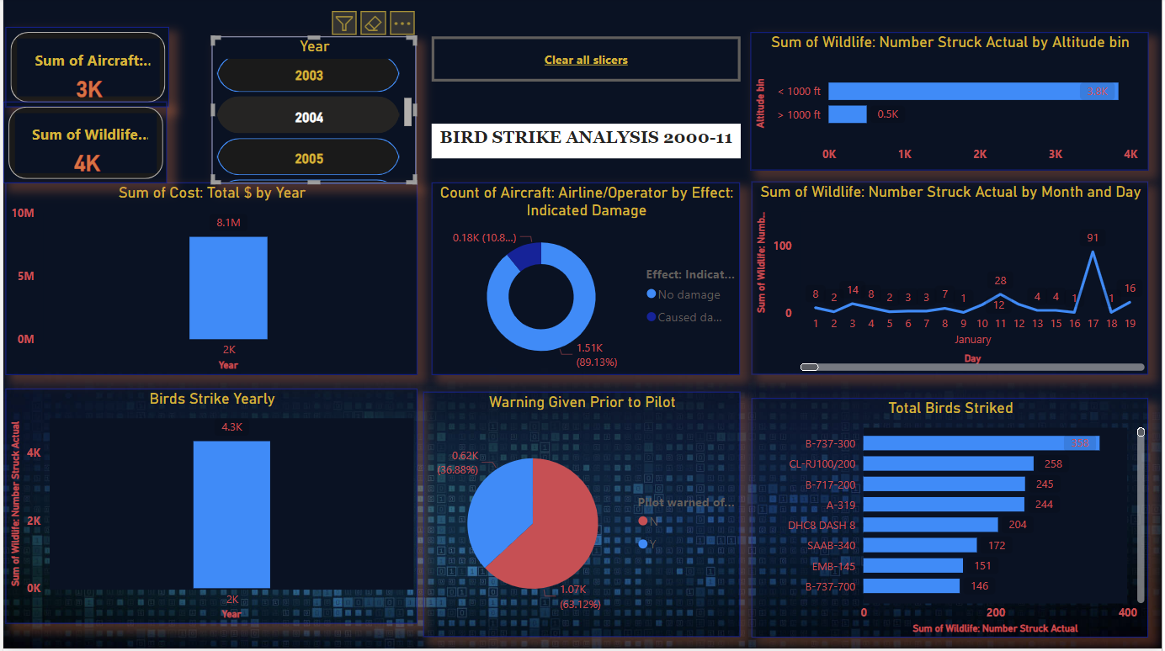
Year Wise representation:-
3000 aircrafts striked with 5000 birds in year 2004.
Total damage costs around 8.1M.
Unwarned strike is more in this year.
358 birds were striked with aircraft B-737-300

Slide 8
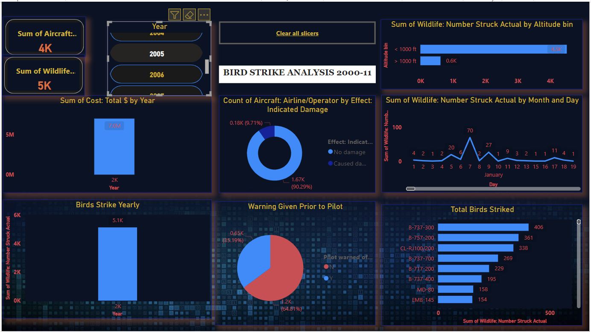
Year Wise representation:-
4000 aircrafts striked with 5000 birds in year 2005.
Total damage costs around 7M.
Unwarned strike is more in this year.
406 birds were striked with aircraft B-737-300

Slide 9
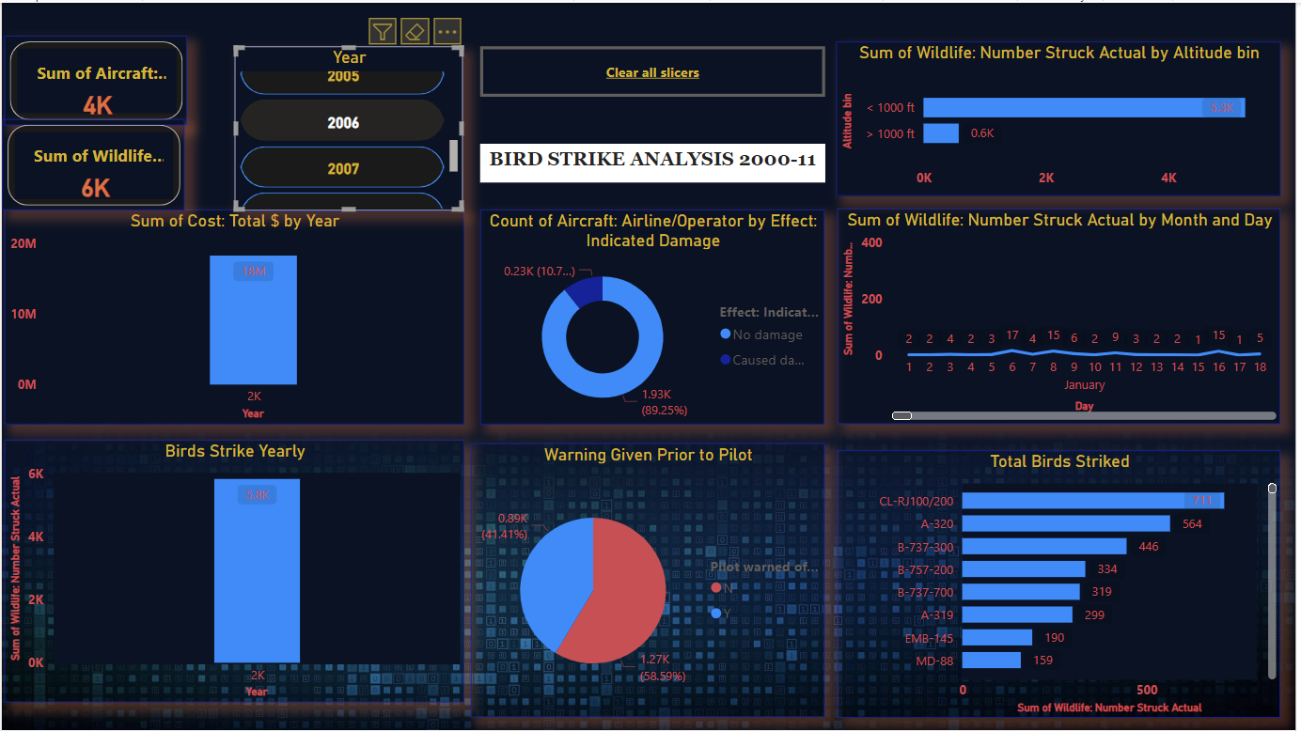
Year Wise representation:-
4000 aircrafts striked with 6000 birds in year 2006.
Total damage costs around 18M.
Unwarned strike is more in this year.
711 birds were striked with aircraft CL-RJ100/200.

Slide 10
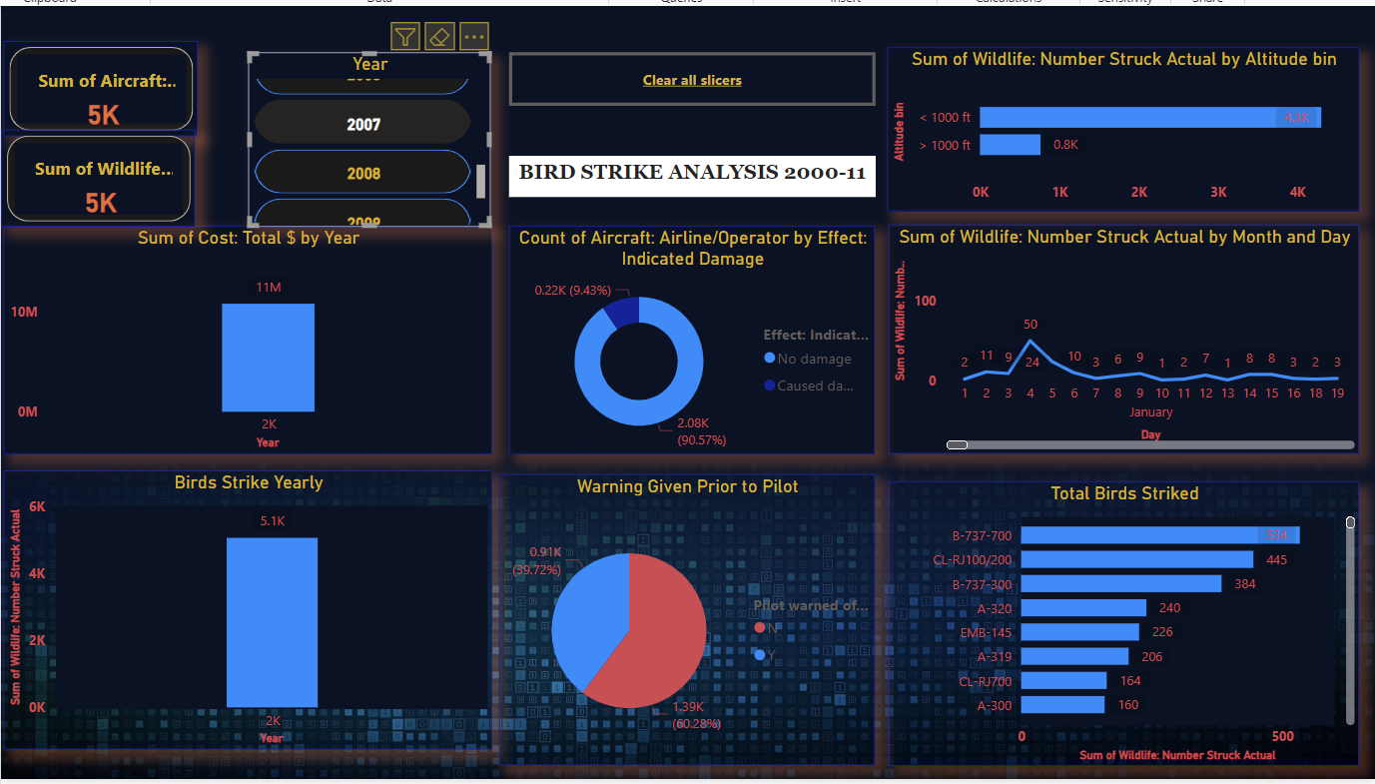
Year Wise representation:-
5000 aircrafts striked with 5000 birds in year 2007.
Total damage costs around 11M.
Unwarned strike is more in this year.
534 birds were striked with aircraft B-737-700.

Slide 11
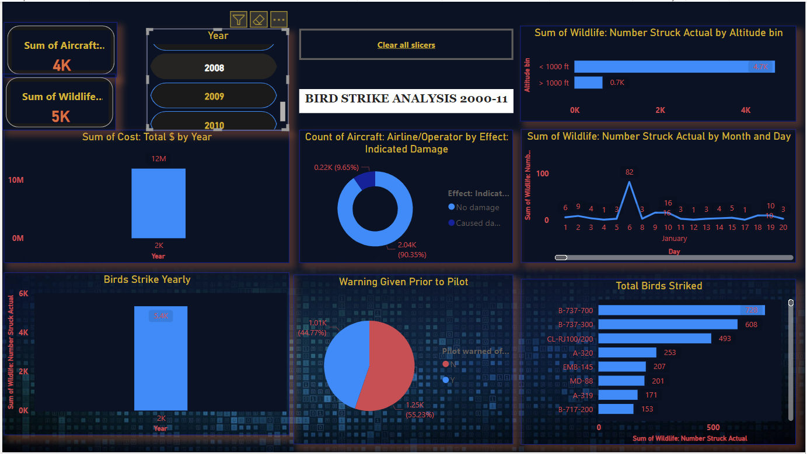
Year Wise representation:-
4000 aircrafts striked with 5000 birds in year 2008.
Total damage costs around 12M.
Unwarned strike is more in this year.
728 birds were striked with aircraft B-737-700.

Slide 12
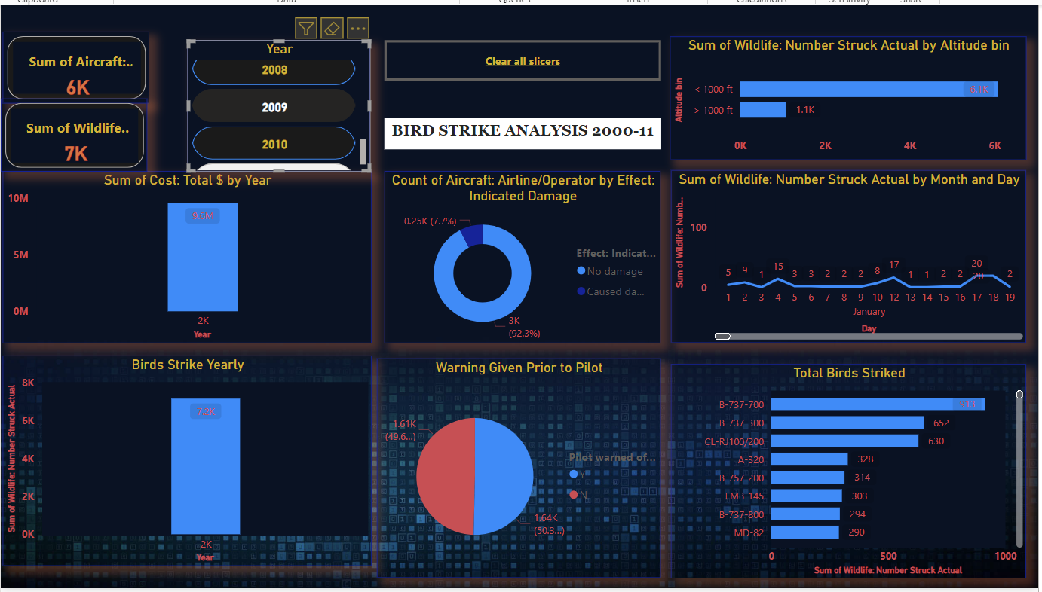
Year Wise representation:-
6000 aircrafts striked with 7000 birds in year 2009.
Total damage costs around 5.6M.
Unwarned strike is more in this year.
913 birds were striked with aircraft B-737-700

Slide 13
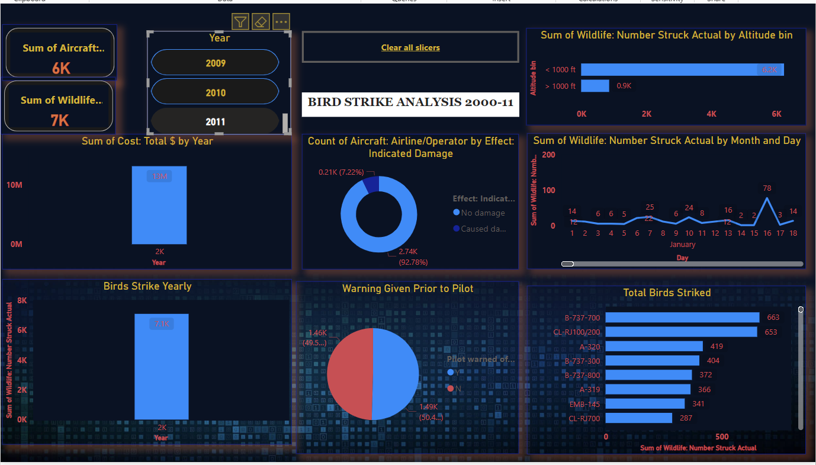
Year Wise representation:-
6000 aircrafts striked with 7000 birds in year 2011.
Total damage costs around 13M.
Unwarned strike is more in this year.
663 birds were striked with aircraft B-737-700.

Slide 14
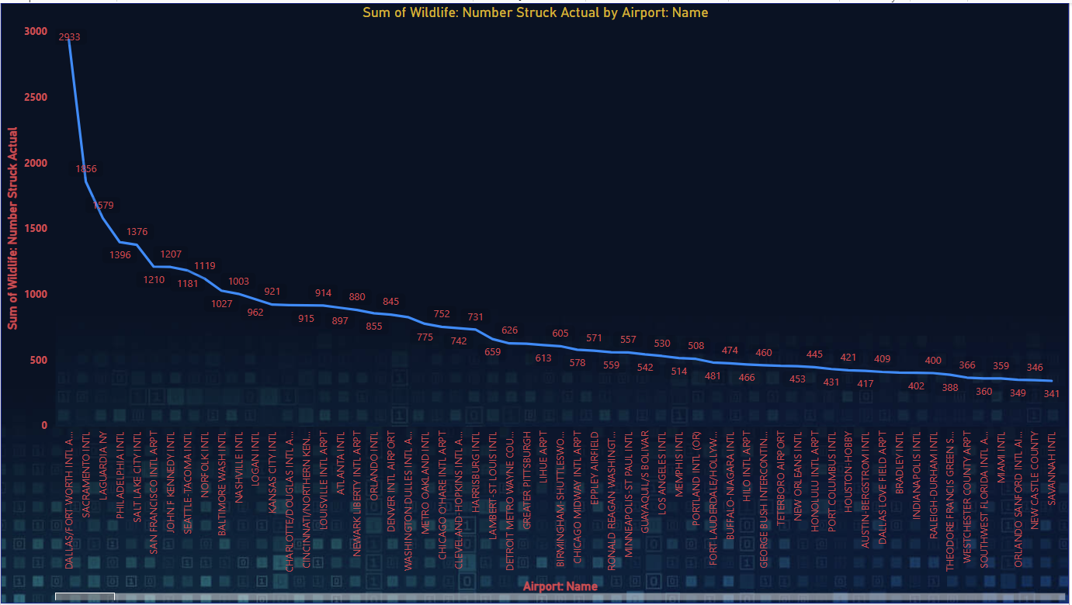

Slide 15
